Slide 1
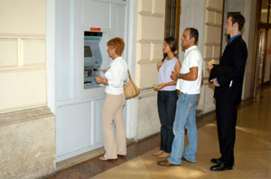

The M/G/1 Queue
Richard C. Larson
1.203J, 15.073J, IDS.700
Wednesday, November 7, 2017

Slide 2
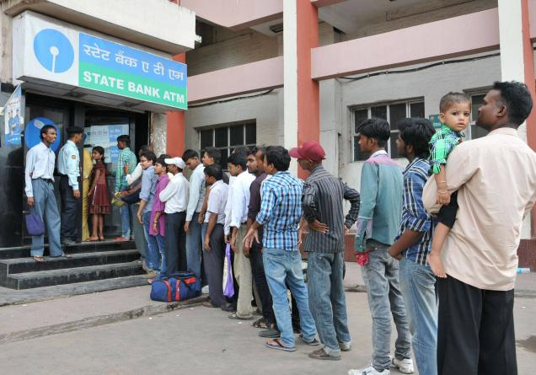
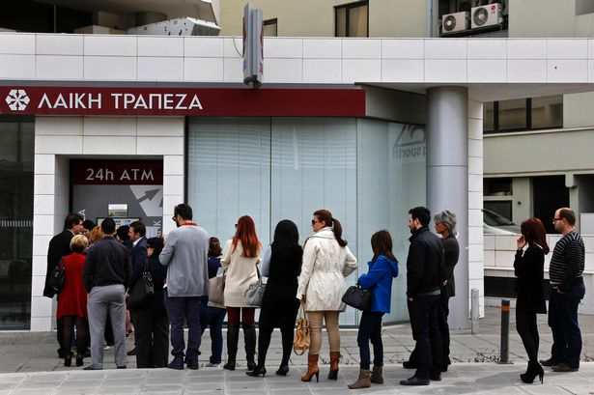
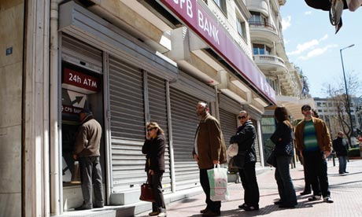

Slide 3
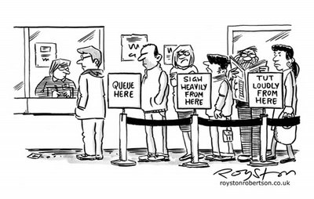
Remarks
What do we recall about the M/M/1 queue?
How might the M/G/1 queue be Better? Worse?
Why not the M/G/2 queue?
Each customer’s departure time is a “magic moment,” a point of no memory!

Slide 4

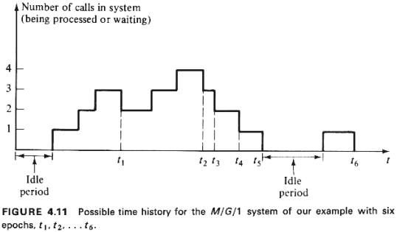

Slide 5
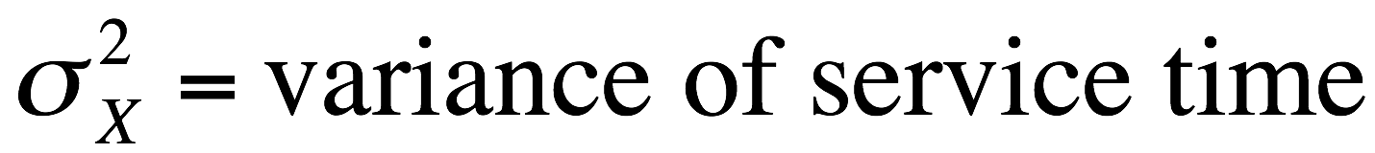
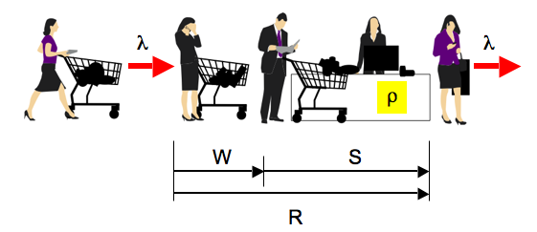
Parameters
We have the usual queue parameters
λ = mean Poisson arrival rate
(1/μ) = mean service time
ρ = λ/μ <1 (server utilization factor)

Slide 6

Time to
Buckle your
Seatbelts!
Remember,
“Buy One,
Get Three
for Free!”

Slide 7
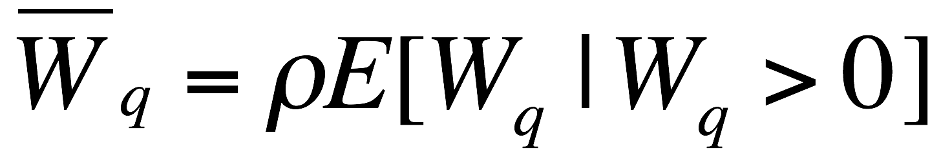
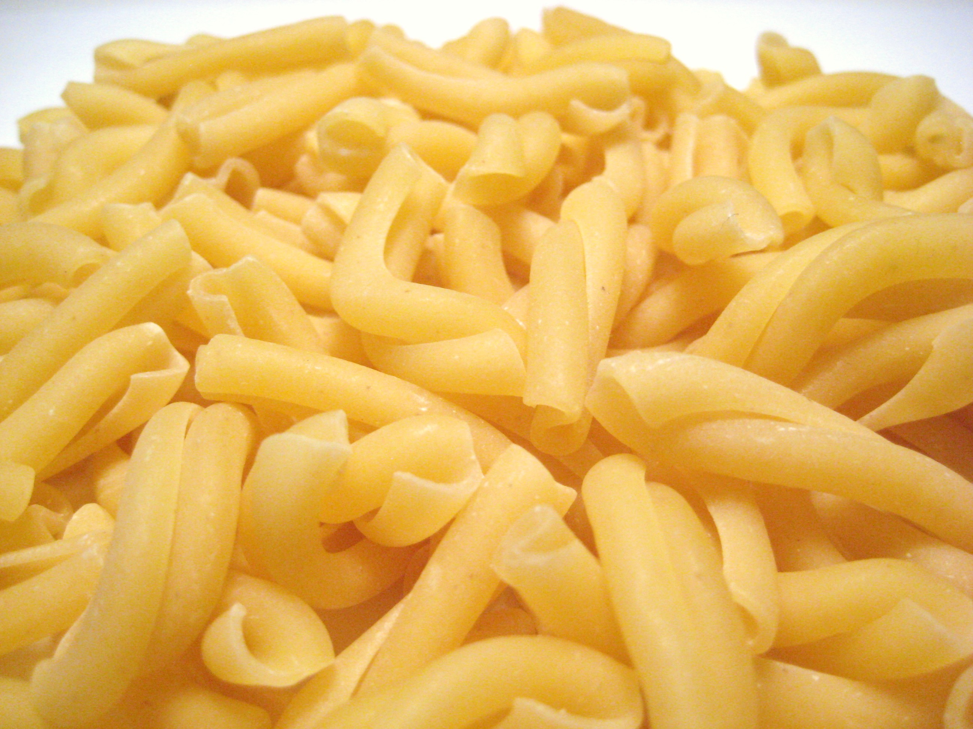
We Seek the
Mean In-Queue Waiting Time W_{q}
Consider the arrival of a “test customer”
How can we make 2nd statement?

Slide 8

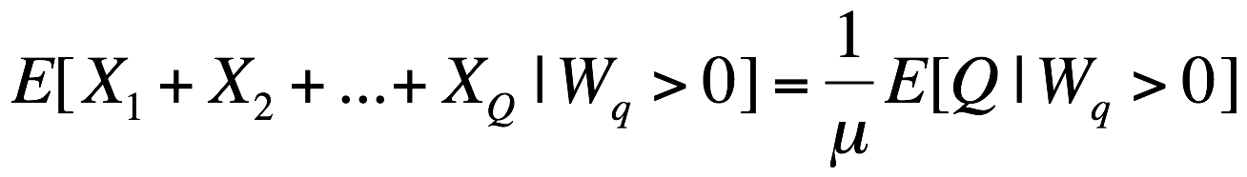
Let
Q = number of customers already in queue (=0,1,2,…)
X_{i} service time of i^{th} customer in queue, i=0, 1, 2,…
R remaining service time of customer in service
Then,
We know E[X_{i}] = 1/μ and that the X_{i}’s are independent of Q.

Slide 9
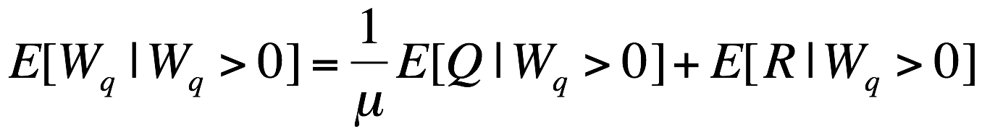
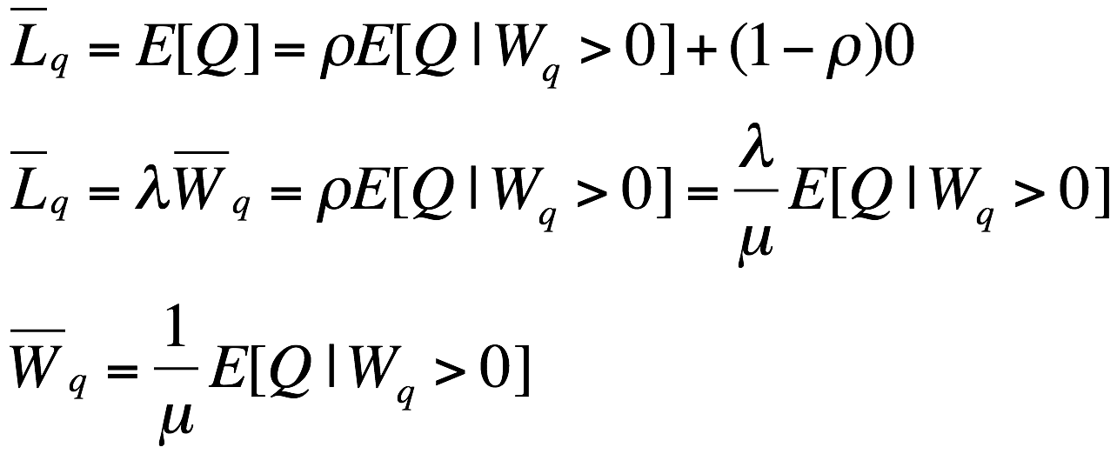
Summarizing progress,
Following the logic of the 1st equation, we can write

Slide 10
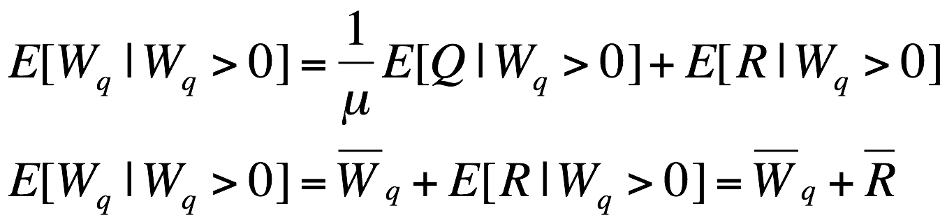
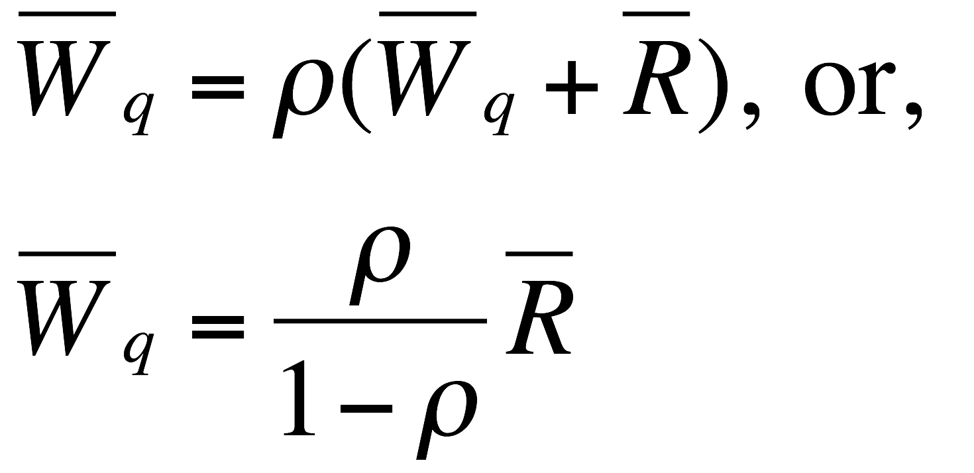

Remember,
Therefore,

Slide 11
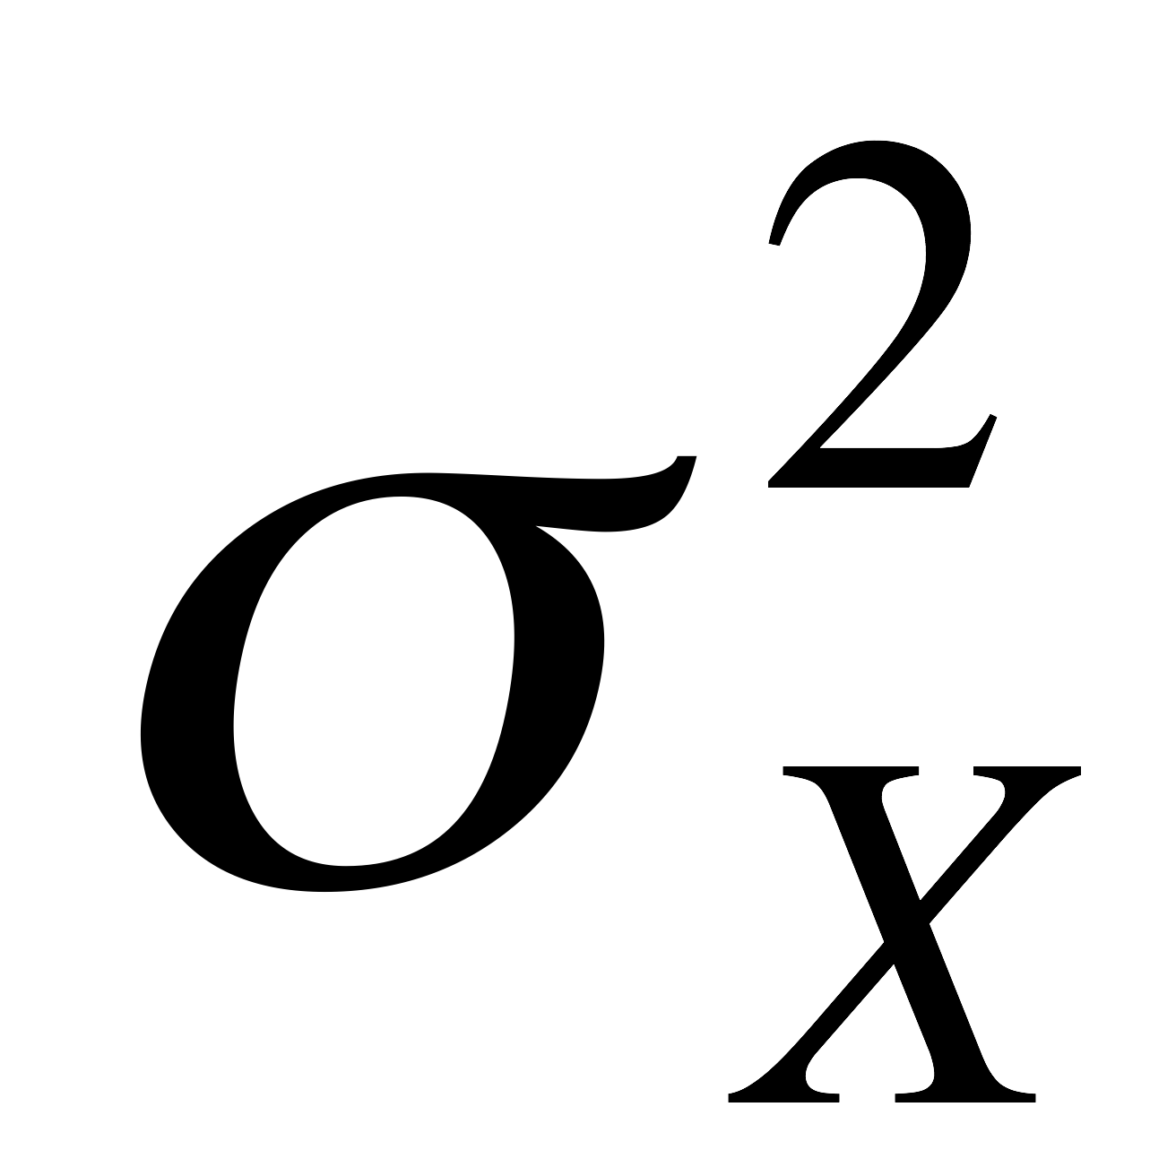
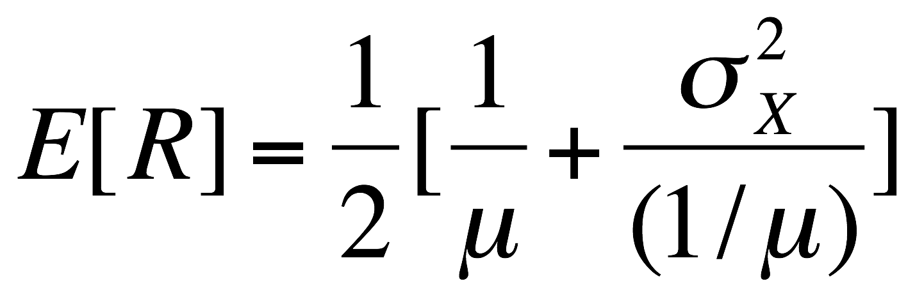
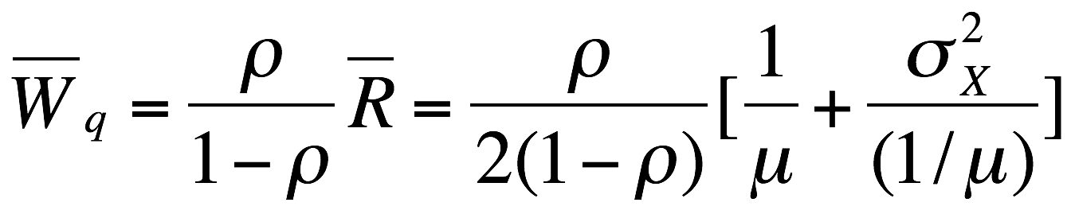
Reduced to Finding E[R]
But this is just a case of random incidence: If the pdf for the service time has mean (1/μ) and variance , then
So,

Slide 12
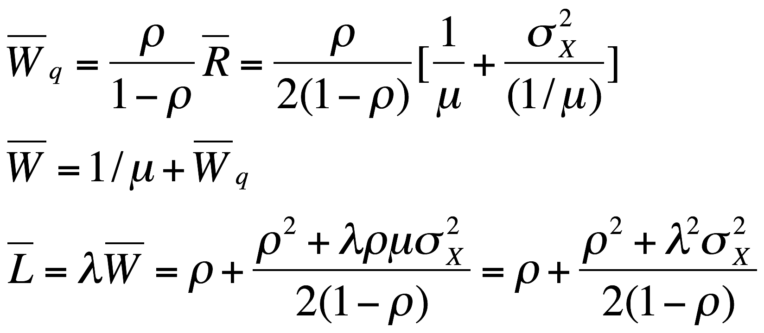

Slide 13
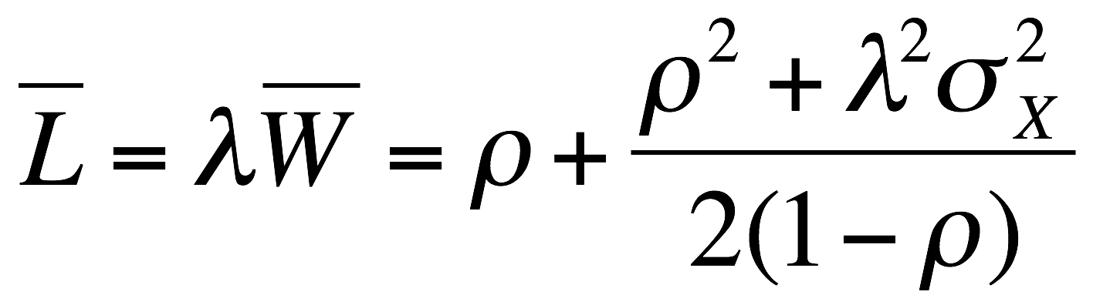

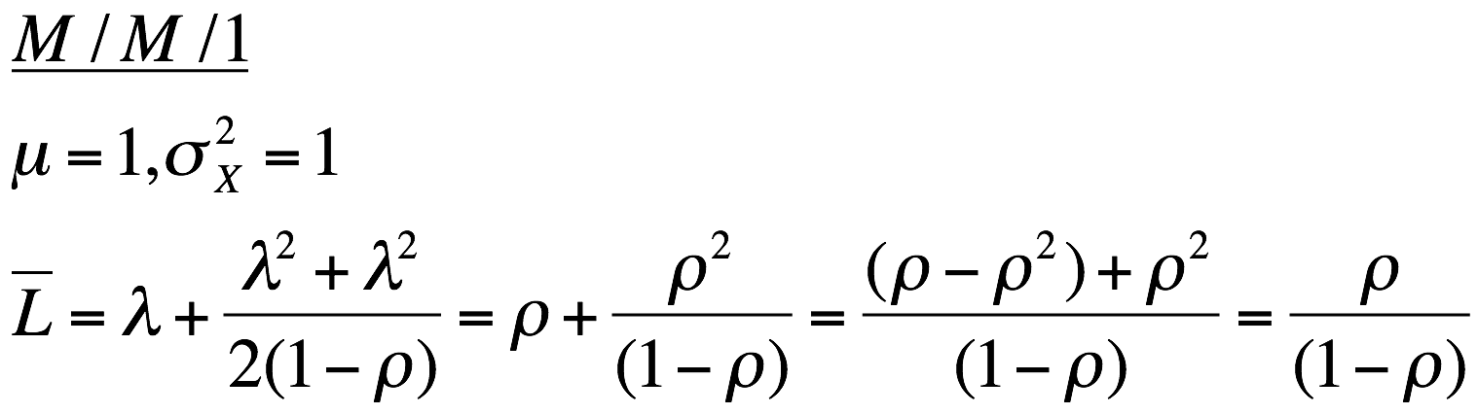
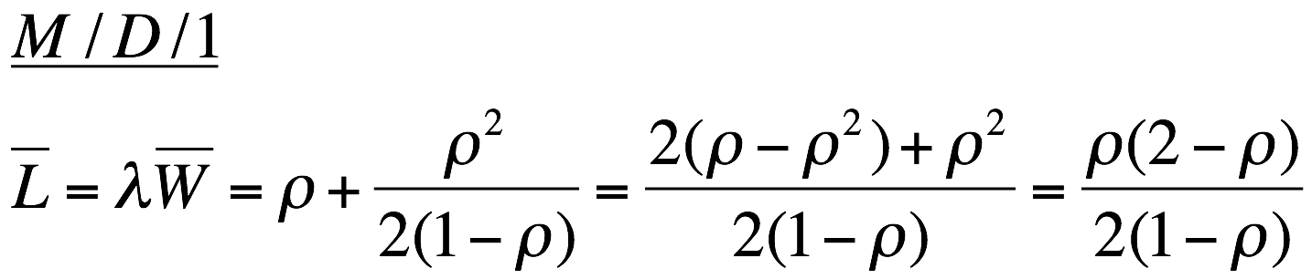
Sanity Checks:

Slide 14
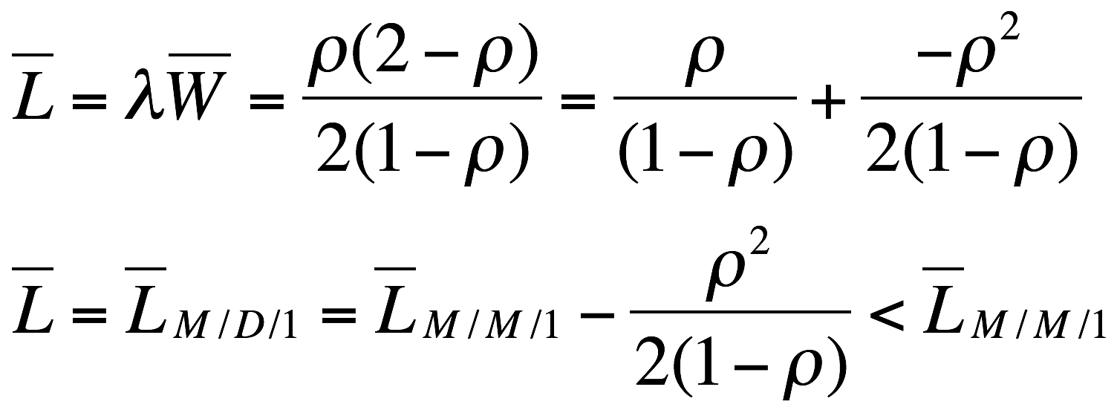
ρ = ε?
ρ =1− ε?

Slide 15
Now Time to
Unbuckle your
Seatbelts!
http://www.census.gov/pubinfo/www/multimedia/img/seatbelt-lo.jpg

Slide 16

Any Questions About Queues?

